Slide 1
临床NGS生物信息流程验证的标准及指南 Standards and Guidelines for Validating NextGeneration Sequencing Bioinformatics Pipelines
A Joint Recommendation of the Association of Molecular Pathology(AMP) and the College of American Pathologists(CAP)
蔡正厅
医学信息分析部

Slide 2
主要参考文献
Roy S, Coldren C, Karunamurthy A, et al. Standards and Guidelines for Validating Next-Generation Sequencing Bioinformatics Pipelines: A Joint Recommendation of the Association for Molecular Pathology and the College of American Pathologists[J]. Journal of Molecular Diagnostics Jmd, 2017.

Slide 3

Outline
NGS技术
NGS生信分析指南的需求（略）
NGS技术简介（略）
生信分析流程
定义及术语
序列产生
序列比对
突变识别
突变过滤
突变注释
突变优化级排序
研究工作
工作成员（略）
研究范围
研究局限
文献系统性调研
指南内容
17条建议

Slide 4
Outline
NGS技术
NGS生信分析指南的需求（略）
NGS技术简介（略）
生信分析流程
定义及术语
序列产生
序列比对
突变识别
突变过滤
突变注释
突变优化级排序
研究工作
工作成员（略）
研究范围
研究局限
文献系统性调研
指南内容
17条建议

Slide 5
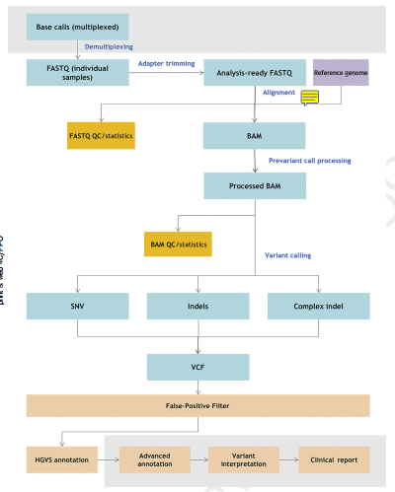
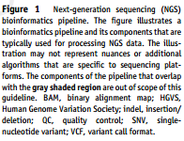
1.3 生物信息流程
Bioinformatics Pipeline
定义(Definition)
生物信息学是一门以大分子为基础将生物学概念化，然后运用信息学技术（应用数学，计算机科学和统计学）理解和管理与这些分子相关的海量信息的学科。
生物信息学算法以预先设定的顺序处理NGS数据，统称为NGS生物信息学分析流程。
Bioinformatics is the discipline that conceptualizes biology in terms of macromolecules and then applies informatics techniques (applied math, computer science, and statistics) to understand and organize the information associated with these molecules, on a large scale.
Bioinformatics algorithms executed in a predefined sequence to process NGS data are collectively referred to as the NGS bioinformatics pipeline.
术语表(Glossary)

Slide 6
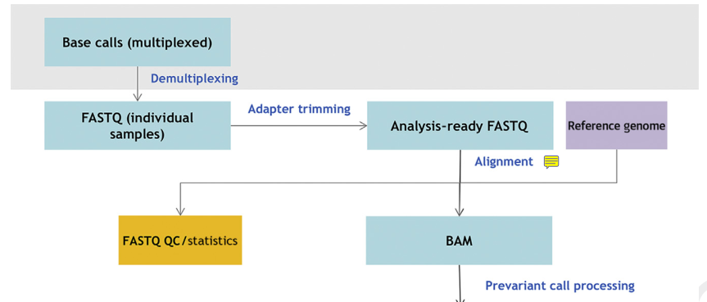
1.3 生物信息流程
Bioinformatics Pipeline
序列生成(Sequence Generation)
Signal processing and base calling, stored in FASTQ files.
序列比对(Sequence Alignment)
Align with a reference genome after QC, stored in BAM files.
CRAM：The latest encrypted version

Slide 7
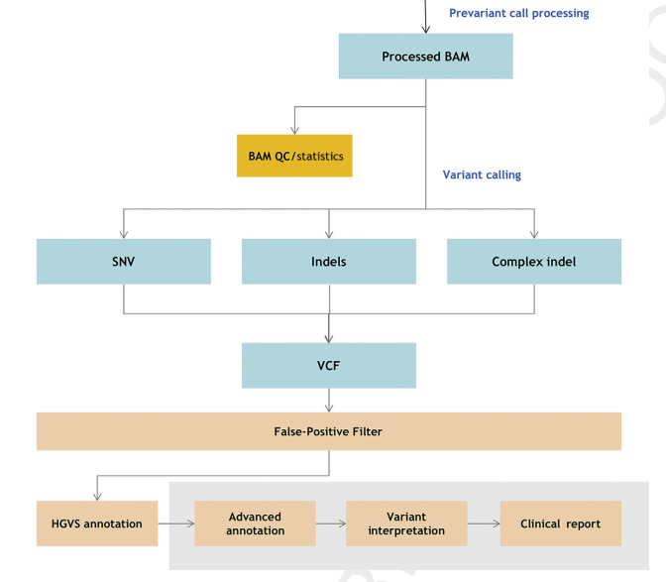
1.3 生物信息流程
Bioinformatics Pipeline

Slide 8
1.3 生物信息流程
Bioinformatics Pipeline
突变识别(Variant Calling)
Identify sequence variants, the types including SNV, indels, CNV, etc.
Represented by standard variant call format(VCF).
突变过滤(Variant Filtering)
Filter the false-positive artifacts.
突变注释(Variant Annotation)
Characterize each called variant.
(E.g. Variant location, predicted cDNA, amino acid sequence change, allele frequencies and prevalence in variant databases.)
突变优先级排序(Variant Prioritization)
Identify clinically insignificant variants, known and unknown clinically significant variants for further review and interpretation.

Slide 9
Outline
NGS技术
NGS生信分析指南的需求（略）
NGS技术简介（略）
生信分析流程
定义及术语
序列产生
序列比对
突变识别
突变过滤
突变注释
突变优化级排序
研究工作
工作成员（略）
研究范围
研究局限
文献系统性调研
指南内容
17条建议

Slide 10
2.2 研究范围
Charge and Scope
不大于21bp长度的SNVs, indels和多核苷酸置换。
Detection of SNVs, indels, and multinucleotide substitutions (HGVS terminology) comprising a length of 21 bp or less from both somatic and germline human origin.
2.3 研究局限
Limitations
do not address clinical validation or clinical utility of an NGS test.
do not address large indels >21 bp in length, structural variants, gene fusion variants and translocations, gene expression variations, epigenetic variants, copy number alterations, and other variants not defined as SNVs or small indels.

Slide 11
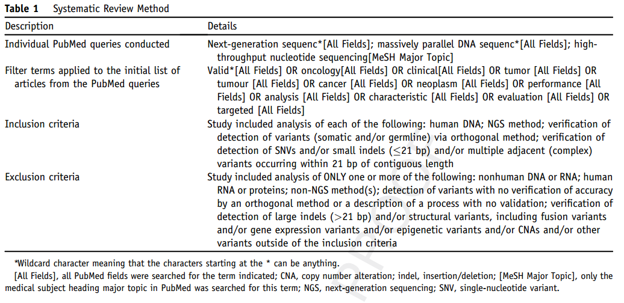
2.3 文献系统性调研
Systematic Evidence Review
Retrieval：PubMed
Assess：查准率(Precision)和查全率(recall)
Attempt 1: 太多假阳性( too many false postives)
Notes:
Picture: http://www.sohu.com/a/31486052_162758

Slide 12
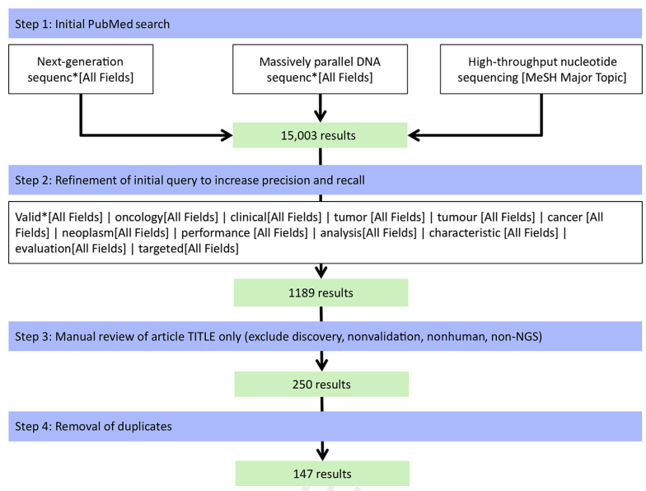
2.3 文献系统性调研
Systematic Evidence Review
Attempt2: refine query subsequently，review of article titles

Slide 13
2.3 文献系统性调研
Systematic Evidence Review
Phase1: 24 selected articles
Only the abstract and the title of each retrieved item
were reviewed independently by two different members of the working group .
Criteria: the article met inclusion criteria and concomitantly did not meet any of the exclusion criteria.
When evaluation by the two reviewers was not congruent, a third working group member was assigned to review the abstract, also in a blinded manner, and generate a final decision.（酷似高考作文改卷）

Slide 14
2.3 文献系统性调研
Systematic Evidence Review
Phase 2: 14 selected articles
The full text of the article was reviewed .
capture a list of consensus-derived predefined data elements for each article using Survey Monkey.
Results：
A clear absence of uniformity in the methods adopted for bioinformatics pipeline validation. 明确生信分析流程的统一规范的缺失。
The limited number of such studies and the high degree of variability between studies certainly reinforce the need for guidance in NGS bioinformatics pipeline validation.

Slide 15
Outline
NGS技术
NGS生信分析指南的需求（略）
NGS技术简介（略）
生信分析流程
定义及术语
序列产生
序列比对
突变识别
突变过滤
突变注释
突变优化级排序
研究工作
工作成员（略）
研究范围
研究局限
文献系统性调研
指南内容
17条建议

Slide 16
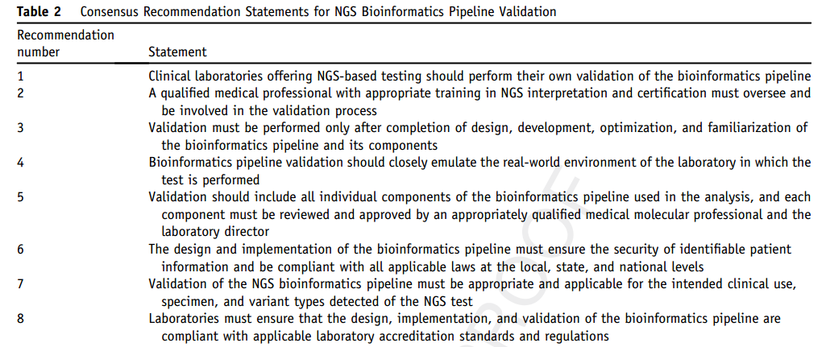
3.1 指南内容
Guideline with17 consensus recommendations

Slide 17
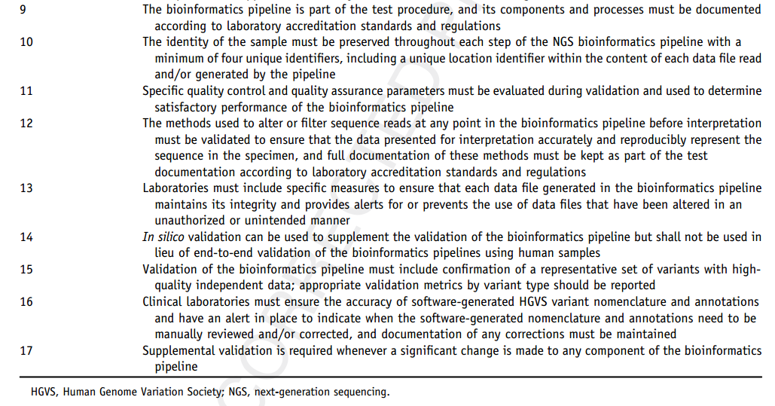
3.1 指南内容
Guideline with17 consensus recommendations

Slide 18
3.1 指南内容
Guideline with17 consensus recommendations
必要性
Clinical laboratories offering NGS-based testing should perform their own validation of the bioinformatics pipeline. 临床实验室在提供NGS报告时需要进行生信分析流程的验证。
A qualified medical professional with appropriate training in NGS interpretation and certification must oversee and be involved in the validation process. 有经验的并接受过NGS解读特殊训练及资质认证的医学（分子学）专家参与并审核整个的验证流程。
Validation must be performed only after completion of design, development, optimization, and familiarization of the bioinformatics pipeline and its components. 验证需要在生信分析流程的设计、开发、优化及熟悉化完成之后进行。
Supplemental validation is required whenever a significant change is made to any component of the bioinformatics pipeline. 流程中任何一个部分改变都需要进行补充验证。
专家参与
验证位置

Slide 19
3.1 指南内容
Guideline with17 consensus recommendations
Bioinformatics pipeline validation should closely emulate the real-world environment of the laboratory in which thetest is performed. 生信分析流程验证需要尽可能地模拟现实的实验室环境及条件。
Validation should include all individual components of the bioinformatics pipeline used in the analysis, and each component must be reviewed and approved by an appropriately qualified medical molecular professional and the laboratory director. 生信分析流程中所有的子成分都需要进行验证，同时每一部分都需要医学分子学专家或者实验室负责人进行审核并同意。
The design and implementation of the bioinformatics pipeline must ensure the security of identifiable patient information and be compliant with all applicable laws at the local, state, and national levels. 生信分析流程的设计和实施需要保护病人的隐私，并且遵守当地的法律。
外包问题
隐私法律

Slide 20
3.1 指南内容
实验室要求
Guideline with17 consensus recommendations
Laboratories must ensure that the design, implementation, and validation of the bioinformatics pipeline are compliant with applicable laboratory accreditation standards and regulations 实验室必须确保整个的生信分析流程的设计、实施和验证过程符合实验室的认证标准和规定。
The bioinformatics pipeline is part of the test procedure, and its components and processes must be documented according to laboratory accreditation standards and regulations 生信分析作为整个检测流程的一部分，需要对其各成分及个步骤按照实验室规定进行记录和存档。
符合实验室规定(required by laboratory accreditation agencies)
协助开发人员排查系统问题(troubleshooting problems)
减少系统崩溃后恢复的时间(reducing the recovery time)

Slide 21
3.1 指南内容
数据要求
Guideline with17 consensus recommendations
Laboratories must include specific measures to ensure that each data file generated in the bioinformatics pipeline maintains its integrity and provides alerts for or prevents the use of data files that have been altered in an unauthorized or unintended manner 实验室必须使用特定手段确保流程中生成的数据文件的完整性，并提供警告或防止数据文件非正当的使用。
完整性(completeness) & 可追溯性(traceability)
FASTQ/VCF: 不包含明确的文件尾标志(end-of-file flag)
常见方法：
检查文件确切的大小(checking exact file sizes)
Hash/checksum method
The MD5 Message-Digest Algorithm
National Institute of Standards and Technology Computer Security Resource Center, Hash Functions

Slide 22
3.1 指南内容
Guideline with17 consensus recommendations
样本要求
Validation of the NGS bioinformatics pipeline must be appropriate and applicable for the intended clinical use, specimen, and variant types detected of the NGS test. NGS流程的验证必须与NGS检测中所涉及的临床应用、样本和突变类型相适配。

Slide 23
3.1 指南内容
Guideline with17 consensus recommendations
LOD and Variant Allele Fraction Reference Ranges 检测极限和突变丰度的参考值范围
Representative samples(the 15th)
Limit of Detection(LOD)
设置最低的覆盖深度(the minimum depth of coverage)
设置最低的突变丰度(the minimum variant allele fraction)
对低细胞量的样品LOD的验证十分重要(low-cellularity samples)：胰腺囊肿、脑脊液……
Reference Ranges
※ 为了确认胚性杂合、纯合、半合子，以及镶嵌型，需要使用临床明确的阳性样本建立并验证相关的参考值范围。

Slide 24
3.1 指南内容
Guideline with17 consensus recommendations
Contiguous Genetic Regions 连续遗传区域
特点
这些区域的序列通常比较特殊：低复杂度(low complexity)，GC-rich，同聚体序列(homopolymeric sequences)……
解决方法
对特定区域进行质控：覆盖深度、碱基质量、比对质量、单链偏好性；
验证时加入该区域的标准品(representative)，确保分析流程能准确鉴定出该区域；
如果得不到理想的精度，应该在检测报告中告知局限性。

Slide 25
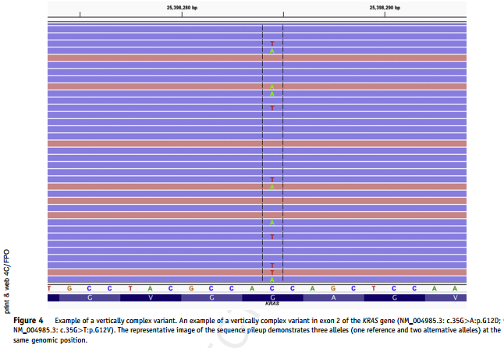
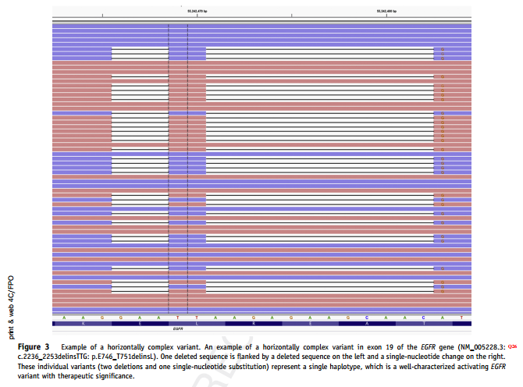
3.1 指南内容
Guideline with17 consensus recommendations
Horizontally and Vertically Complex Variants （横向的和纵向的）复杂突变类型
Horizontally Complex Variants
Two or more sequence alterations are present on the same read in close proximity such that they may represent a single complex variant.
同一个read中有两个及以上的突变。
Vertically Complex Variants
Three or more alleles are represented by different sequence reads, typically with or uncommonly without a reference (normal) allele, at the same genomic coordinate or set of coordinates.
同一个位点有两个及以上的突变(reads)。

Slide 26
3.1 指南内容
Guideline with17 consensus recommendations
Variants that Require Additional Algorithms 需要额外算法的突变
FLT3基因有一段内部串联重复(internal tandem duplication) 和急性髓性白血病(acute myeloid leukemia)，通常这个区域需要特定的算法进行识别。
Minimum Number of Wet Laboratory Samples to Include in the Validation Sample Set 最小的样本（类型）数量
样本类型不足的解决方法
增加合适的验证样本；
购买商业可使用的参考材料；
使用已经审核过的电子样本(in silico samples)。

Slide 27
3.1 指南内容
Guideline with17 consensus recommendations
Minimum Number of Variants to Include in the Validation Sample Set 最小的突变数量
经过筛选的典型复杂(临床致病)突变位点及基因。
突变数的计算公式：
n = ln(1-CL)/ln(P)
where n is the number of variants, CL is the confidence level of detection, and P is the probability of detection.
取95%的置信水平和95%的准确率，根据计算至少需要有59种不同的SNV、indels和复杂突变。
没有足够的突变类型用于验证，应该在检测报告中告知局限性。

Slide 28
3.1 指南内容
Guideline with17 consensus recommendations
Failure to Detect a Variant in the Validation Sample Set 未成功处检测突变
解决方法：
用可视化的方法审核数据(visual method, eg, using IGV);
样本被破坏或不合适需要更换成合适的样本；
样本合适，需要先调整分析流程及参数，不应该贸然更换样本。

Slide 29
3.1 指南内容
Guideline with17 consensus recommendations
样本标识符
identity of the sample must be preserved throughout each step of the NGS bioinformatics pipeline with a minimum of four unique identifiers, including a unique location identifier within the content of each data file read and/or generated by the pipeline. 在生信分析的每一步流程中，样本至少需要包含4个唯一标识符（需要包含于数据文件内由流程产生供流程读取）。

Slide 30
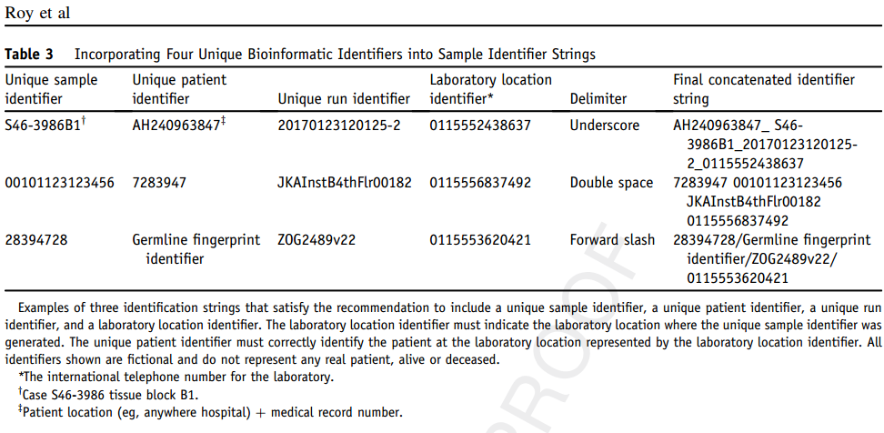
3.1 指南内容
Guideline with17 consensus recommendations
Unique Identifiers
四种唯一标识符：
唯一样本标识符、病人标识符、运转标识符、实验室标识符
常用生信文件格式缺陷：
由科研发展而来，不够严谨全面，包含序列突变、比对等信息，不包含样本、病人、运转和实验室信息。
其他：
基于SNP的病人“指纹”标识符，
Health level 7：(Health Level Seven International, http://www.hl7.org, last accessed March 23, 2017).

Slide 31
3.1 指南内容
Guideline with17 consensus recommendations
In silico
In silico validation can be used to supplement the validation of the bioinformatics pipeline but shall not be used in lieu of end-to-end validation of the bioinformatics pipelines using human samples 计算机模拟的验证方法可以作为一种补充，但是不能完全替代整个的生信分析流程的验证。

Slide 32
3.1 指南内容
Guideline with17 consensus recommendations
In silico validation
现实情况中，很难得到足够丰富的样本用于验证试验，目前有团队开始使用经过人工审核加工的电子样本(in silico samples)，主要研究如下。
多组机构FASTQ数据分享(Davis et al.)
样本类型：实体瘤样品(solid tumor samples)
研究过程：几个实验室用同样类型的文库和机器生成数据进行共享，分别使用各自的生信方法进行数据分析。
研究结果：在SNV的识别上高度一致，在indels的识别上一致性相对较低。

Slide 33
3.1 指南内容
Guideline with17 consensus recommendations
In silico validation
现实情况中，很难得到足够丰富的样本用于验证试验，目前有团队开始使用经过人工审核加工的电子样本(in silico samples)，主要研究如下。
多组FASTQ数据混合分析(Duncavage et al.)
样本类型：in silico FASTQ文件(两组NGS实体瘤试剂产生)
研究过程：上述的FASTQ文件中引入大量的突变，被分配到不同的实验室进行分析。
研究结果：各实验室都能成功地鉴定出相关的突变位点。

Slide 34
3.1 指南内容
Guideline with17 consensus recommendations
In silico validation
现实情况中，很难得到足够丰富的样本用于验证试验，目前有团队开始使用经过人工审核加工的电子样本(in silico samples)，主要研究如下。
小结
上述研究基于实验室能力比对验证检测(proficiency testing)
电子样本的确可以对实体的样本验证检测进行补充，但是无法完全替代；
该方面的尝试相对较新，对流程的设计、电子样本的准确性要求很高，对相关的生信人员专业要求较高；
研究采用多少电子样本可参考验证过程中的专家意见。

Slide 35
3.1 指南内容
Guideline with17 consensus recommendations
标准品
Validation of the bioinformatics pipeline must include confirmation of a representative set of variants with high quality independent data; appropriate validation metrics by variant type should be reported. 验证过程中需要使用其他独立的方法对标准品的突变位点进行确认； 突变类型的验证指标需要在报告中体现。

Slide 36
3.1 指南内容
Guideline with17 consensus recommendations
High quality independent data
the reference data should be generated using a high-quality and orthogonal (ie,different) clinically validated method 标准品还需要高质量和 不同的方法进行突变位点的确认；
the same systematic false-negative and false-positive properties 用同一种方法确认会存在系统性的假阳性和假阴性问题。
样本确认时仍采用同一种方法应该在检测报告中告知局限性

Slide 37
3.1 指南内容
Guideline with17 consensus recommendations
Validation metrics
最大indel 长度(maximum indel length)；
不同的突变类型需要分别使用不同的精度指标
突变类型：SNV、indel、复杂突变
指标：TN、TP、FN、FP、sensitivity、specificity……
灵敏度：measured by the same sample using an independent methods
置信区间：Wilson scores better than traditional(Wald) method
特异性：actual true negatives are not always well known in a validation study, for the basis of measuring specificity is not uniform.

Slide 38
3.1 指南内容
质量控制
Guideline with17 consensus recommendations
Specific quality control and quality assurance parameters must be evaluated during validation and used to determine satisfactory performance of the bioinformatics pipeline 具体的质量控制及其参数需要合理估计，并满足生信分析需要。
The methods used to alter or filter sequence reads at any point in the bioinformatics pipeline before interpretation must be validated to ensure that the data presented for interpretation accurately and reproducibly represent the sequence in the specimen, and full documentation of these methods must be kept as part of the test documentation according to laboratory accreditation standards and regulations 在解读前，何一步进行数据选择或者过滤必须要保证最终用于解读的数据准确性和可重复性；并且上述数据过滤所涉及的所有方法都需要按照实验室规定记录存档。

Slide 39
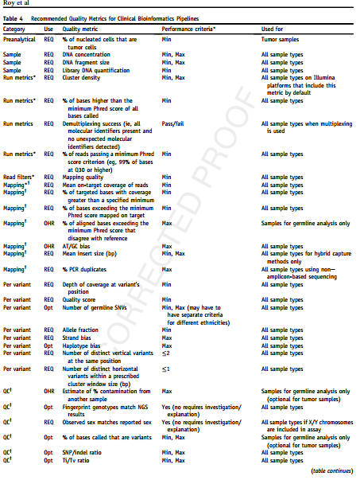
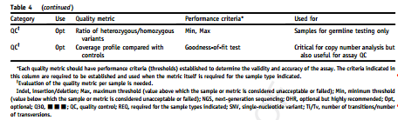
3.1 指南内容
Guideline with17 consensus recommendations
Quality Control

Slide 40
3.1 指南内容
Guideline with17 consensus recommendations
Quality Control
强调
Read coverage（覆盖率及深度）
在设定的基因组窗口内检测到复杂突变，需要被标记为密切关注区域，而不应该将其误以为人为误差而过滤掉； Flags should be set to review data more closely when vertically or horizontally complex variants are detected within a defined genomic window;
明确污染或交叉污染的概率，尤其是中高通量的胚性细胞检测

Slide 41
3.1 指南内容
Guideline with17 consensus recommendations
Alter or Filter
强调
数据过滤时涉及的质控指标不包含于建议11中，必须要事先验证保证数据经过过滤后还能保持准确性； it is performing as expected and not filtering out data that contribute to an accurate representation of the sequence in the specimen.
二种过滤上的错误（假阳性SNP ）：由于参考基因错误，导致杂合误判为纯合，纯合误判为杂合。

Slide 42
3.1 指南内容
Guideline with17 consensus recommendations
解读要求
Clinical laboratories must ensure the accuracy of software-generated HGVS variant nomenclature and annotations and have an alert in place to indicate when the software-generated nomenclature and annotations need to be manually reviewed and/or corrected, and documentation of any corrections must be maintained 确保由软件生成的突变术语和注释准确性；并报告中表明突变注释由软件自动生成，还是由人工审核校正，校正内容需要记录存档。

Slide 43
3.1 指南内容
Guideline with17 consensus recommendations
Nomenclature and Annotations
HGVS nomenclature：人类基因组突变协会关于突变的术语
目前，很多VCF注释文件都采用HGVS术语进行注释，但在实践过程中存在挑战，尤其是对indels和复杂突变。
Left 5’versus Right 3’Alignment：在注释indels时，基因组坐标为左对齐，而HGVS为右对齐；
Variant Normalization：parsimonious and left；
Choice of Transcript：按情况而定。
Other：胚性或者体细胞突变（尤其是肿瘤细胞）不易使用自动注释，对用于胚性鉴定的样本和方法有一定要求。

Slide 45
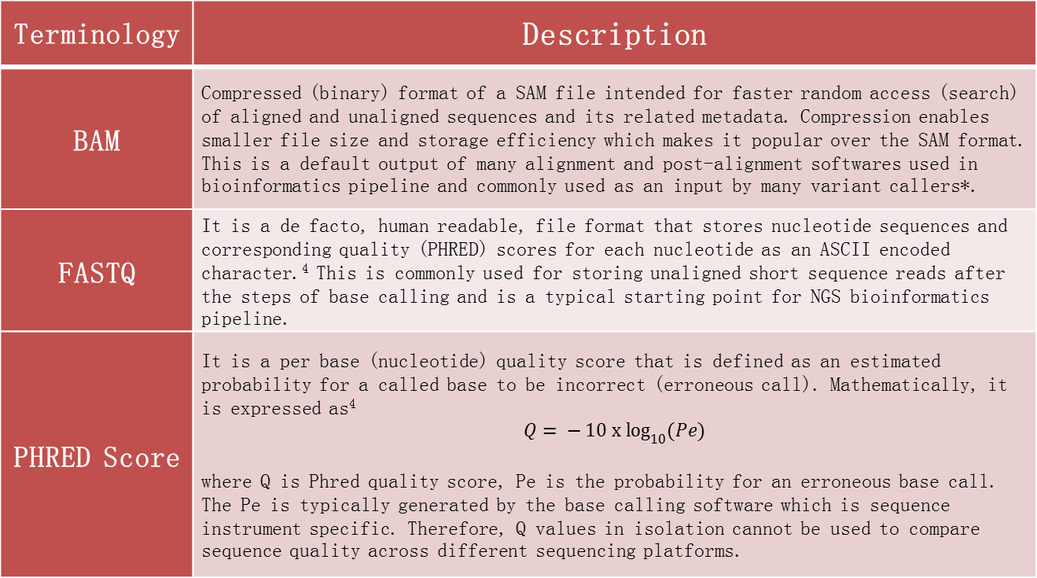
The Glossary of Next-Generation Sequencing (NGS) and Bioinformatics Pipeline–Related Terminologies
Terminology | Description
BAM | Compressed (binary) format of a SAM file intended for faster random access (search) of aligned and unaligned sequences and its related metadata. Compression enables smaller file size and storage efficiency which makes it popular over the SAM format. This is a default output of many alignment and post-alignment softwares used in bioinformatics pipeline and commonly used as an input by many variant callers*.
FASTQ | It is a de facto, human readable, file format that stores nucleotide sequences and corresponding quality (PHRED) scores for each nucleotide as an ASCII encoded character.⁴ This is commonly used for storing unaligned short sequence reads after the steps of base calling and is a typical starting point for NGS bioinformatics pipeline.
PHRED Score | It is a per base (nucleotide) quality score that is defined as an estimated probability for a called base to be incorrect (erroneous call). Mathematically, it is expressed as⁴ $$Q= −{10 x log}_{10}{(Pe)}$$ where Q is Phred quality score, Pe is the probability for an erroneous base call. The Pe is typically generated by the base calling software which is sequence instrument specific. Therefore, Q values in isolation cannot be used to compare sequence quality across different sequencing platforms.
Notes:
* Sequence Alignment/Map Format Specification, https://samtools.github.io/hts-specs/SAMv1.pdf, last accessed 9/28/17.
†The Variant Call Format (VCF) Version 4.2 Specification, https://samtools.github.io/hts-specs/VCFv4.2.pdf, last accessed 9/28/17.

Slide 46
The Glossary of Next-Generation Sequencing (NGS) and Bioinformatics Pipeline–Related Terminologies
Terminology | Description
SAM | Stands for Sequence Alignment/Map format. It is a human readable (text file) file format specification for storing information on aligned sequence. This is a default output of many alignment softwares used in bioinformatics pipeline. Given the large file size and slower random access, BAM format is preferred for routine bioinformatics data processing. This format is helpful for technical troubleshooting when manual review of the stored information is necessary*.
Variant - horizontally complex | When two or more sequence alterations are present on the same read in close proximity such that they may represent a single complex variant. These variants are frequently represented as deletion-insertions and may result in ambiguous sequence description or HGVS nomenclature.
Variant - Left-aligned | If there are multiple potential VCF entries of the same allele length that represent the same variant, then left-alignment refers to the VCF entry with the smallest base position. The base position is typically represented in genomic coordinate for a given primary assembly (eg, GRCh38) and represents the most 5’ position.⁵
Notes:
* Sequence Alignment/Map Format Specification, https://samtools.github.io/hts-specs/SAMv1.pdf, last accessed 9/28/17.
†The Variant Call Format (VCF) Version 4.2 Specification, https://samtools.github.io/hts-specs/VCFv4.2.pdf, last accessed 9/28/17.

Slide 47
The Glossary of Next-Generation Sequencing (NGS) and Bioinformatics Pipeline–Related Terminologies
Terminology | Description
Variant - Normalized | A normalized variant must be parsimonious as well as left-aligned.⁵
Variant - Parsimony | If there are more than one way to represent the same variant in a VCF file, parsimony refers to the representation with the shortest possible allele length⁵ (positive and non-zero length).
Variant - vertically complex | A vertically complex variant occurs when three or more alleles are represented by different sequence reads, typically with or uncommonly without a reference (normal) allele, at the same genomic coordinate or set of coordinates.
VCF | Variant Call Format is a versioned, text-file (human readable) specification for storing sequence variant calls. The file contains meta-information containing various details of the variant calling process and definition of headers and format tags, a header line and data lines. Each data line represents a sequence variant defined using a combination of chromosome, position, reference allele, and alternate allele†.
Notes:
* Sequence Alignment/Map Format Specification, https://samtools.github.io/hts-specs/SAMv1.pdf, last accessed 9/28/17.
†The Variant Call Format (VCF) Version 4.2 Specification, https://samtools.github.io/hts-specs/VCFv4.2.pdf, last accessed 9/28/17.

Slide 48
Specific Restrictions Regarding Genetic Information
the Health Insurance Portability and Accountability Act of 1996(HIPAA; US Government Publishing Office, https://www.gpo.gov/fdsys/pkg/PLAW-104publ191/html/PLAW-104publ191.htm, last accessed March 23,2017)
the Health Insurance Reform: Security Standards(Final Security Rule; US Government Publishing Office, https://www.hhs.gov/sites/default/files/ocr/privacy/hipaa/ administrative/securityrule/securityrulepdf.pdf, last accessed December 19, 2016)
the Health Information Technology for Economic and Clinical Health Act(US Health and Human Services, https://www.healthit.gov/sites/ default/files/hitech_act_excerpt_from_arra_with_index.pdf, last accessed November 7, 2017)
the Genetic Information Nondiscrimination Act(US Government Publishing Office, https://www.hhs.gov/ohrp/regulationsand-policy/guidance/guidance-on-genetic-information-non discrimination-act/index.html, last accessed December 19, 2016)
the HIPAA Omnibus Rule (US Government Publishing Office, https://www.gpo.gov/fdsys/pkg/FR-2013-01-25/pdf/2013-01073.pdf, last accessed December 19, 2016).

Slide 49
Specific Restrictions Regarding Genetic Information
the Australian Privacy Act of 1988 (Office of the Australian Information Commissioner, https://www.oaic.gov.au/privacy-law/privacy-act, last accessed August 29, 2016)
the European Union General Data Protection Regulation (EUR-Lex, http://eur-lex.europa.eu/legalcontent/EN/TXT/?uriZuriserv:OJ.L_.2016.119.01.0001.01.ENG&tocZOJ:L:2016:119:TOC, last accessed August 29,2016)
the Canadian Privacy Act and Personal Information Protection and Electronic Documents Act(Office of the Privacy Commissioner of Canada, https://www.priv.gc.ca/resource/fs-fi/02_05_d_15_e.asp, last accessed August 29, 2016).

Slide 50
Examples of Complex, Potentially Clinically Significant Sequence Variants.
Gene | Nucleotide Description | Protein Description | Reason for complexity
EGFR | NM_005228.3:c.2236_2253delGAATTAAGAGAAGCAACAinsTTG | p.Glu746_Thr751delinsLeu | Horizontally complex variant, SNV and a deletion flank a larger deletion (Figure 3)
KRAS | NM_004985.3:c.35G>A; NM_004985.3:c.35G>T | p.Gly12Asp; p.G12Val | Vertically complex variant (Figure 4)
FLT3 | Internal tandem duplication (ITD) | Gain of function | Duplication with or without insertion of a variable sequence (3 to 400bp) into the FLT3 gene. Such inframe mutations confer a gain of function rather than loss of function. Both the size of the alteration and variability in flanking sequence create challenges.

Slide 51
Examples of Complex, Potentially Clinically Significant Sequence Variants.
Gene | Nucleotide Description | Protein Description | Reason for complexity
BRCA2 | NM_000059.3:c.1813dupA | p.Ile605Asnfs | In short homopolymer repeat. Left/right shuffling may create different representations. Some NGS methods produce artifacts at such sites, and mutations may be vertically heterogeneous.
BRCA2 | NM_000059.3:c.1310_1313delAAGA | p.Lys437Ilefs | In short quad-nucleotide repeat. Left/right shuffling may create different representations.
BRCA2 | NM_000059.3:c.5007_5008insAluY | Protein disruption | Large insertion of a transposable element (Alu). These inserted sequences are typically variable.

Slide 52
Examples of Complex, Potentially Clinically Significant Sequence Variants.
Gene | Nucleotide Description | Protein Description | Reason for complexity
MLH1 | NM_000249.3:c.1852_1854delAAG | p.Lys618del | In short tri-nucleotide repeat. Left/right shuffling may create different representations.
MLH1 | NM_000249.3:c.232_243delGAAAGGTTCACTinsATGTAAGG | p.Glu78Metfs*2 | Complex call - different variant calling algorithms may represent this alteration differently, including as multiple independent variants.
MSH2 | NM_000251.2:c.942+3A>T | Splice affecting | In long homopolymer repeat. All current NGS methods produce artifacts at such sites, and mutations will be vertically heterogeneous.
MSH6 | NM_000179.2:c.2056_2060delGGTTGinsCTTCTACCTCAAAAA | p.Gly686Leufs | Complex call - different variant calling algorithms may represent this alteration differently, including as multiple independent variants.

Slide 53
Examples of Complex, Potentially Clinically Significant Sequence Variants.
Gene | Nucleotide Description | Protein Description | Reason for complexity
PMS2 | NM_000535.5:c.2243_2246delAGAA also NM_000535.5:c.2253T>C | NP_000068.1:p.Ala68Leu also NP_478102.2:p.Arg82Leu | SNV near indel, both are in pseudogene associated region of PMS2, highly homologous to PMS2CL
CDKN2A | NM_000077.4:c.9_32dupGGCGGCGGGGAGCAGCATGGAGCC | p.Pro11_Ser12insAlaAlaGlySerSerMetGluPro | Mutation is 3rd copy of repeat in an endogenous tandem duplication; Also this region is 80% GC and low complexity.
CDKN2A | NM_000077.4:c.202_203delCCinsTT and NM_058195.3:c.245_246delCCinsTT | p.Ala68Leu and p.Ala68Leu respectively | These two variants are the same and affect the two different gene products (p14ARF and P16INK4a) of the CDKN2A locus

Slide 54
Examples of Complex, Potentially Clinically Significant Sequence Variants.
Gene | Nucleotide Description | Protein Description | Reason for complexity
TP53 | NM_000546.5:c.215_221delCCGTGGCinsGTG | p.Pro72Argfs*50 | At end of homopolymer repeat region. Complex call - different variant calling algorithms may represent this alteration differently.
MSH2 | NM_000251.2:inv exons 1-7 (“Boland inversion”) | Loss of protein | Breakpoints in non-coding regions, requires specialized bioinformatics.

